Slide 1
Foreign Currency Exchange Rate Prediction using models consisting of ARIMA and Random Forest
Student Name Student ID
Adeepta Shushil Shuvo 20-43092-1
MD. Zahid Hasan 20-42802-1
MD. Asif Al Mamun 20-43132-1
Nuzhat Tanzina Prova 20-43869-2
Supervised by Prof. Dr. Md. Asraf Ali Externally Examined by Dr. Muhammad Firoz Mridha

Slide 2
Outline
Introduction
Background
Problem Statement
Objectives
Methods
Results and Discussion
Conclusion
Future Works
References
Q&A

Slide 3
Introduction

Slide 4
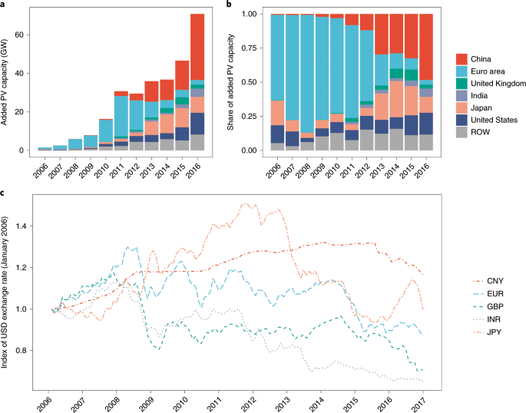
Introduction (continued.)
Foreign Currency Exchange Rates:
Foreign currency exchange rates represent the value of one currency compared to another and determine the rate at which currencies can be traded on the global market [1].
Mainly exchange rates refer to–
Determine the value of one currency in terms of another.
Facilitate global trade and investments.
Fluctuate based on supply, demand, economic conditions, geopolitical factors, and market sentiment [2].

Slide 5
Introduction
Importance of Predicting Exchange Rates:
With the foreign currency market being the most overhanging financial market worldwide, it has been understandable to predicting exchange rates is vital [3,4] as-
It's essential for global trade, investments, and economic stability.
Helps businesses, investors, and policymakers make smart choices.
Influences import/export costs, inflation rates, and interest rates.
Assists in planning ahead, managing risks, and improving financial results.

Slide 6
Background

Slide 7
Background
Some Techniques for Predicting Currency Exchange Rates:
Time series analysis method: Exponential Smoothing and Seasonal Decomposition, are commonly used for exchange rate prediction.[5]
Neural network model: Particularly Long Short-Term Memory (LSTM) networks, are increasingly utilized to capture nonlinear dependencies within exchange rate data.[2]
Traditional model: Autoregressive Integrated Moving Average (ARIMA) analyze past exchange rate data to find patterns.[5]
Machine learning algorithm: Random Forest Regression (RFR) use computational power to predict future exchange rate movements.[6]
Our research combines ARIMA and Random Forest models to enhance the accuracy of forecasting currency exchange rates.

Slide 8
Problem Statement

Slide 9
Problem Statement
Due to the complex interaction of variables including market outlook, international advancements, and economic data, accurately predicting foreign currency rates is extremely difficult [7].
Conventional approaches, such as technical and fundamental studies, are not very good at capturing the complex and dynamic patterns that are present in exchange rate fluctuations. The dynamic character of the worldwide economy imparts a degree of uncertainty [8].
Current models frequently come up short of providing an in-depth understanding of the interdependencies within the data. [9]

Slide 10
Problem Statement
A stronger and more reliable forecasting framework is clearly needed, especially as companies and decision-makers depend more and more on precise estimates to guide risk management and strategic financial planning [10].
Implementing a unique hybrid model called the ARIMA-Random Forest model, this research intends to fill in the gaps and overcome the obstacles that currently exist in foreign exchange rate prediction [11].

Slide 11
Research Questions
How accurate is the combining ARIMA-Random Forest model at forecasting major currency exchange rates relative to the USD?
What special advantages and contributions to the accuracy of currency value estimates do each of the hybrid model's components ARIMA and Random Forest bring?
What insights does the suggested hybrid model offer into the reliability of its forecasting abilities, and how does it adjust to changing market conditions?

Slide 12
Objectives

Slide 13
Objectives
To predict an optimized Foreign Currency Exchange Rate.
To develop a new hybrid model based on ARIMA and REF models.
To predict foreign currency exchange rate the accuracy with large amount of data.
To prediction accuracy is better than our existing models.

Slide 14
Methods

Slide 15
Methods
Data collection
The dataset was collected from Kaggle.
This dataset includes 113 currencies in total with exchange values in varied permutations.
It can be used for various tasks like time series analysis and forecasting.

Slide 16
Methods (continued.)
Dataset Validation
We check the missing values in our dataset.
Remove outliers in Dataset.
Convert the date column to Date Time.
Check the stationery.

Slide 17
Methods (continued.)
Dataset Preprocessing
Data was preprocessed by applying statistical data processing techniques.
Feature Engineering:
improve the model's performance.
understanding trends or patterns in currency values.

Slide 18
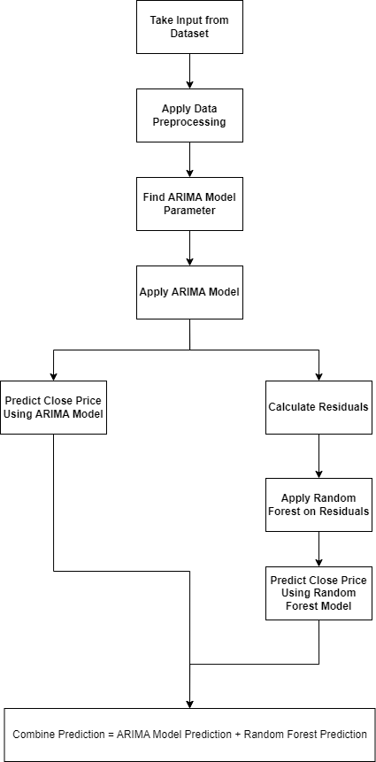
Methods (continued.)
Proposed Model
This model used ARIMA for linear datasets and Random Forest non-linear datasets.
Different layers were used to make the model efficient.

Slide 19
Methods
Data Measurement Matrices
RMSE: It is a standard way to measure the error of a model in predicting quantitative data. It represents the square root of the second sample moment of the differences between predicted values and observed values or the quadratic mean of these differences.
MSE: It is a widely used metric for measuring the quality of a model in statistics and machine learning. It is the average squared difference between the estimated values and the actual value.
MAE: It’s used to measure the average absolute difference between the predicted values and the actual values.

Slide 20
Results and Discussion

Slide 21
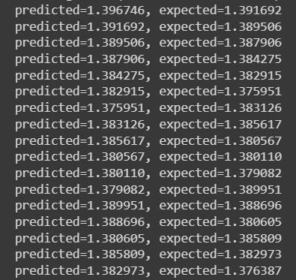

Results and Discussion
By applying ARIMA Model:
Arima Model RMSE: 0.00550
Arima Model MSE: 0.00003
Arima Model MAE: 0.00454
By applying Random Forest Model on Residuals:
RF Model RMSE: 0.00656
RF Model MSE: 0.00004
RF Model MAE: 0.00515

Slide 22
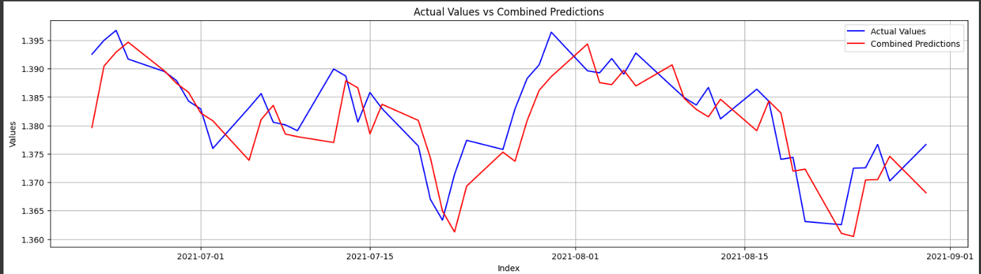
Results and Discussion
Combine Prediction:
Combine RMSE: 0.00584
Combine MSE: 0.00003
Combine MAE: 0.00466

Slide 23
Results and Discussion
Comparison between our proposed model accuracy and others
Authors and Number of models/ Classifiers/ Algorithms Used | Dataset | Using Models/ Classifiers | Accuracy
Lu, Changhui. "The Long Short-Term Memory of GBP/CNY Exchange Rate Forecasts." 2022 [2] | GBP/CNY exchange rate. | ARIMA, LSTM and GRU Model | RMSE - 2.28%, MAE - 7.48%
M. Qureshi, N. Ahmad, S. Ullah, and A. Raza ul Mustafa (2023) “Forecasting real exchange rate (REER) using artificial intelligence and time series models,” [11] | The real exchange rate data set (REER). | MLP, ELM, ARIMA, EST Model. | MSE - 20.38%
Yong, Y. L., Lee, Y., Gu, X., Angelov, P. P., Ngo, D. C. L., & Shafipour, E. (2018). “Foreign currency exchange rate prediction using neuro-fuzzy systems.” [12] | The historical currency exchange price of the three major currency pairs dataset. | GMMINF, ALMMo | RMSE - 0.0060%, MAPE - 0.3573%
Proposed Model | Currency Foreign Exchange Rates (Modified) | ARIMA and Random Forest | RMSE - 0.00584%, MSE - 0.00003%, MAE - 0.00466%
Comparison with previous study.

Slide 24
Conclusion

Slide 25
Conclusion
Our proposed model performed better on the dataset.
The ability of this model to successfully find not only linear dependencies but also nonlinear dynamics within the dataset.

Slide 26
Future Works

Slide 27
Future Works
Limitations that we want to work in future-
Work over another currency rate for a larger audience.
Making the model more accessible and understandable for users.
We want to predict currency exchange rates based on graphical data rather than statistical datasets.
We want to integrate LSTM to handle more complex temporal relationships and non-linearities not fully addressed by ARIMA.

Slide 28
References

Slide 29
Referencing
1. J. Wang, X. Wang, J. Li and H. Wang, "A Prediction Model of CNN-TLSTM for USD/CNY Exchange Rate Prediction," in IEEE Access, vol. 9, pp. 73346-73354, 2021, doi: 10.1109/ACCESS.2021.3080459
2. Lu, Changhui. "The Long Short-Term Memory of GBP/CNY Exchange Rate Forecasts." 2022 7th International Conference on Social Sciences and Economic Development (ICSSED 2022). Atlantis Press, 2022. doi: 10.2991/aebmr.k.220405.196
3. Das, S.R., Mishra, D. & Rout, M. A hybridized ELM using self-adaptive multi-population-based Jaya algorithm for currency exchange prediction: an empirical assessment. Neural Comput & Applic 31, 7071–7094 (2019). doi.org/10.1007/s00521-018-3552-8
4. Rehman, M., Khan, G. M., & Mahmud, S. A. (2014). Foreign Currency Exchange Rates Prediction Using CGP and Recurrent Neural Network. IERI Procedia, 10, 239–244. doi:10.1016/j.ieri.2014.09.083
5. Asadullah, Bashir, & Aleemi. (2021). “Journal of Asian Finance Economics and Business”, 8(4), 339–347. Doi: 10.13106/jafeb.2021.vol8.no4.033
6.Panda, M. M., Panda, S. N., & Pattnaik, P. K. (2021). Multi currency exchange rate prediction using convolutional neural network. Materials Today: Proceedings. doi:10.1016/j.matpr.2020.11.317

Slide 30
Referencing
7. Rehman, M., Khan, G. M., & Mahmud, S. A. (2014). Foreign Currency Exchange Rates Prediction Using CGP and Recurrent Neural Network. IERI Procedia, 10, 239–244. doi:10.1016/j.ieri.2014.09.083
8. Jena, P. R., Majhi, R., & Majhi, B. (2015). Development and performance evaluation of a novel knowledge guided artificial neural network (KGANN) model for exchange rate prediction. Journal of King Saud University - Computer and Information Sciences, 27(4), 450–457. doi:10.1016/j.jksuci.2015.01.002
9. Aydin, A. D., & Cavdar, S. C. (2015). Comparison of Prediction Performances of Artificial Neural Network (ANN) and Vector Autoregressive (VAR) Models by Using the Macroeconomic Variables of Gold Prices, Borsa Istanbul (BIST) 100 Index and US Dollar-Turkish Lira (USD/TRY) Exchange Rates. Procedia Economics and Finance, 30, 3–14. doi:10.1016/s2212-5671(15)01249-6
10. Saiful Islam, M., & Hossain, E. (2020). Foreign Exchange Currency Rate Prediction using a GRU-LSTM Hybrid Network. Soft Computing Letters, 100009. doi:10.1016/j.socl.2020.100009
11. Moiz Qureshi, Nawaz Ahmad, Saif Ullah, Ahmed Raza Ul Mustafa, Heliyon, Volume 9, Issue 5,2023, e16335, ISSN 2405-8440, doi: 10.1016/j.heliyon.2023.e16335
12. Yong, Y. L., Lee, Y., Gu, X., Angelov, P. P., Ngo, D. C. L., & Shafipour, E. (2018). “Foreign currency exchange rate prediction using neuro-fuzzy systems.” Procedia Computer Science, 144, 232–238. Doi: 10.1016/j.procs.2018.10.523

Slide 31
Q&A
Please feel free to ask any questions.

Slide 32
Thank You

